Slide 1
Clustering in R
Submitted by: mansi

Slide 2
Case Study-1 Market Segmentation for Airlines
Objective: To create clusters out of a broad target market of customers into smaller and more similar groups.
Business Problem: To use clustering for finding similar groups of customers who belong to an airline's frequent flyer program, which consequently helps in trying to learn more about its customers so that it can target different customer segments with different types of mileage offers.

Slide 3
About the Data
The Airlines data has information of 3999 customers each described by 7 variables.
The 7 variables are described below:
Balance | number of miles eligible for award travel
QualMiles | number of miles qualifying for TopFlight status
BonusMiles | number of miles earned from non-flight bonus transactions in the past 12 months
BonusTrans | number of non-flight bonus transactions in the past 12 months
FlightMiles | number of flight miles in the past 12 months
FlightTrans | number of flight transactions in the past 12 months
DaysSinceEnroll | number of days since enrolled in the frequent flyer program

Slide 4
Visualization of data
The first scatter plot shows the distribution of Bonus Miles and Days since enrolment details of all the customers. Similarly, the second plot depicts the Qual miles and Bonus transactions entries of all the customers. Maximum density of points is towards the lower end.

Slide 5
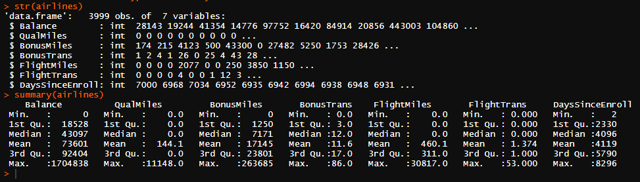
Descriptive Analysis of data
The Airlines data consist of 7 numeric variables. We can judge the mean, median, uniform distribution and the presence of outliers from this. BonusTrans, FlightTrans and DaysSinceEnrol seem to have no extreme outliers.

Slide 6
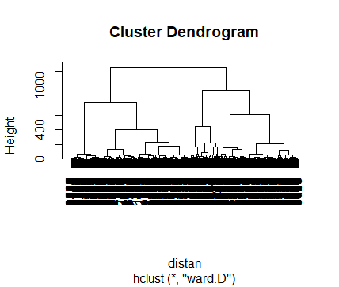
Dendrogram
Once the data is treated for outliers and normalized, we employ the Euclidean method of Hierarchical clustering from which we obtain this dendrogram. It is based on the distance calculation between data points.

Slide 7
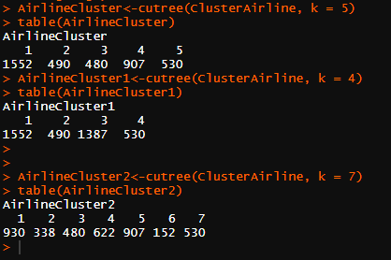
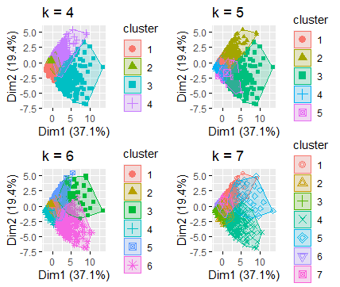
Comparing Clusters
Here, we compare the number of clusters and various combinations of data that they present. Comparing using cutree function as well as scatter plot gives us an idea that k=5,6 or 7 should provide us the best results.

Slide 8
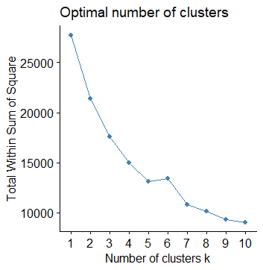
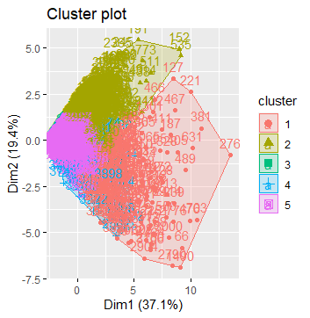

Elbow Method
To find the optimum number of clusters for our data, we use Elbow Method. Form the plot we can definitely conclude that k=5 is the most suited option.

Slide 9
Interpretation and Recommendations
Categorising the customers into 5 clusters is an efficient way for the business to manage its different customer profiles. Of the 3999 different customers, we have 5 clusters showcasing their respective properties.
The cluster consisting of customers which fly very frequently with Business class and tend to spend on products while on board can be introduced with more luxury products and services.
Another cluster that consists of customers which refrain from spending on board, yet travel frequently, can be provided with more schemes like mileage points.
Introduction to more customer specific schemes.

